Slide 1
Introduction to Multi-threading
SET10108 Concurrent and Parallel Systems

Slide 2
Breakdown
Threads, processes and fibers
Scheduling
Models of multithreading
Memory management
Design patterns
C++ multithreading

Slide 3
Threads

Slide 4
What is a thread?
We can look at a number of definitions here
A thread is an independently running part of a program
A thread of execution is independently running part of a process
A thread of execution is the smallest sequence of computer instructions controlled by the operating system (taken from Wikipedia)
For our purposes we will work with the Wikipedia definition. The important part in that definition is that the operating system is managing threads
Some threading libraries are independent of the operating system
C++11 threading does rely on native threading

Slide 5
Processes, threads and fibers
In an operating system, threads form a part of a process
The main difference between a process and a thread is that a process has isolated memory
Threads share the memory of a process
A thread can also be made up of a collection of fibers
A fiber requires scheduling code

Slide 6
Although threads seem to be a small step from sequential computation, in fact, they represent a huge step. They discard the most essential and appealing properties of sequential computation: understandability, predictability, and determinism. Threads, as a model of computation, are wildly non-deterministic, and the job of the programmer becomes one of pruning that nondeterminism.
The Problem with Threads, Edward A. Lee, UC Berkeley, 2006

Slide 7
Scheduling

Slide 8
Schedulers
One of the key aspects of multithreading is scheduling
Scheduling is the method of allocating threads process time to undertake their computation
The operating system in general deals with scheduling – it will try and do this in a fair, round-robin approach
Each thread is given a timeslice
Once the timeslice is complete, the thread is pre-empted and another thread given a timeslice
Each thread is taken one at a time. If it completes it is descheduled

Slide 9
Pre-emptive Multitasking
The previous scheduling model is know as pre-emptive multitasking
Pre-emptive multitasking is an operating system controlled approach
The programmer doesn’t have to worry about the scheduling
C++11 uses this approach – we can’t even set thread priorities in standard C++11
You can get the native handle to do this

Slide 10
Cooperative Multithreading
Cooperative multithreading involves threads determining when they decide to give up processor access
Do you foresee any problems with this approach?
What if one task takes a long time to complete, when some shorter tasks have been waiting?
What about if we are dealing with a real-time system?

Slide 11
Context Switching
Context switching is the term used to describe what happens when we switch threads
Context switching is also the bane of multithreading – part of the reason pre-emptive scheduling can be bad
We need to perform the following steps
Save the current context (thread state, stack, etc.)
Load the context of the thread to be switched to (thread state, stack, etc.)
Continue running the switched into thread
A number of points can cause a context switch
Interrupt
Waiting
Multitasking

Slide 12
I/O and System Calls
One of the main uses of threads is in I/O handling
I/O handling naively and using system calls are actually not code ideas when working with user level threads
The scheduler does not know about the blocking nature of I/O and therefore all threads are blocked
This is a big limitation of cooperative scheduling
Solutions to I/O exist that provide methods of waiting for I/O to become available before performing the actual process

Slide 13
Models

Slide 14
Multithreading Models
Depending on your threading library you are using there is a different mapping between user level threads and operating system threads
A user level thread is one which the programmer can create
There are three models
1:1 mapping
N:1 mapping
M:N mapping
Each have their advantages and disadvantages

Slide 15
Kernel Level Threading
The simplest model – 1 user level thread maps to 1 kernel thread
1:1 mapping
Operating system is responsible for all scheduling – programmer / library developer doesn’t have to worry about anything
Standard model for Win32, Linux, etc.

Slide 16
User Level Threading
User level threading involves all user level threads being mapped to a single kernel level thread
N:1 mapping
This does allow for fast context switching between user threads
Blocking system calls will block all threads however
The kernel thread will be blocked

Slide 17
Hybrid Threading
A compromise between kernel and user level threading
M:N mapping
A kernel thread provides a virtual processor on which user level threads can be executed
User level threads can be quickly switched – just as user level threading
Is complex to implement

Slide 18
Memory Management

Slide 19
Shared Memory
The biggest issue when working with threads is that they share a processes memory
We will look in more depth at controlling memory access next week
We have looked at simple counters and primitives when working with shared memory, but these are not the main issue
Our main problem comes from working with complex data structures such as tables, lists and trees

Slide 20
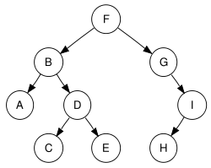
Data Structures
Consider the tree
If we have two threads searching the tree, we can get speed up
If we have two threads modifying the tree we have a problem
We have to use locking mechanisms to protect our data structures

Slide 21
Design Patterns

Slide 22
Concurrency Design Patterns
One of the key aspects of concurrency and multithreading is that we have to control our applications in particular manners
Remember Ed Lee’s quote
As with everything software system based, there are a number of design patterns we can use to ease our system development
We will look at two in more detail
Thread pool
Pipeline
These two you will find most useful, but there are others out there

Slide 23
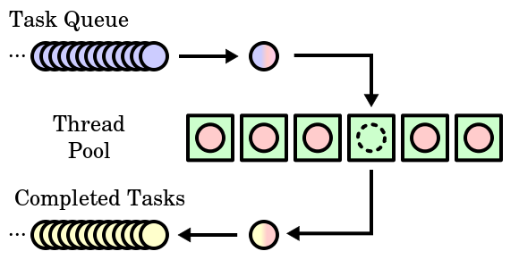
Thread Pool
A thread pool is a common design pattern for multithreading
We have a pool of threads
Optimally matching the number of available hardware threads
We have a queue of tasks
A task is popped from the queue by any available thread in the pool

Slide 24
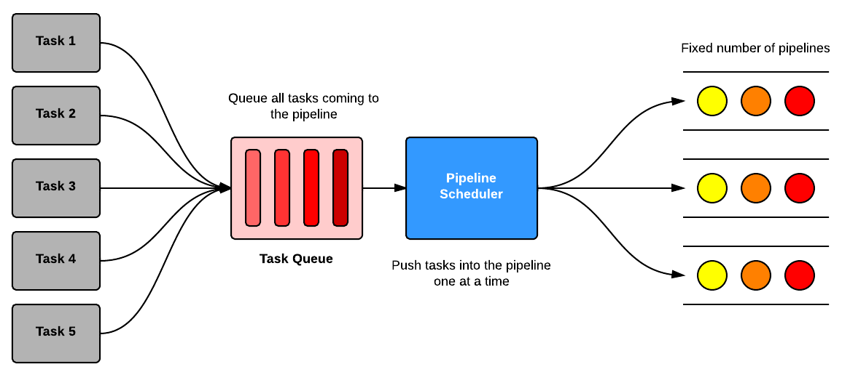
Pipeline
Another popular approach is using a pipeline (or pipelines)
Tasks are queued as before
Tasks are somewhat more data centric now
Each task is sent down the process pipeline
Once stage one of the pipeline is complete, another task can be sent down

Slide 25
C++ Multithreading

Slide 26
Starting a Thread
C++11 added threading support to the standard library
Running a thread in C++11 is trivial
Create a new thread object passing in the function you want to use
Create a new thread object passing in a function object (or a lambda expression)
// Create a new thread
thread t(hello_world);
// Create a thread using a lambda expression
thread t([]{ cout << "Hello from lambda thread!" << endl; });

Slide 27
Joining a thread
C++11 threads are not background threads by default
A background thread doesn’t have to explicitly end for an application to complete
In C++11 all threads must be joined (awaited for completion) unless detached
// Join thread
t.join();
// Detach from thread
t.detach();

Slide 28
Thread interaction
Threads work on a shared memory model
Fast
Difficult to reason about and control
To communicate between threads we need to have some form of shared memory
Although we will look at futures next week
This requires control methods to enable thread interaction
Mutex
Lock
Condition variable

Slide 29
Thread limitations
So how many threads do you think we can start in a C++11 application?
Let’s run a little test
1603 threads – not very many
This is system dependent
Do you know why?

Slide 30
Summary
We have looked at what a thread is and where it sits in the model of the operating system
We have also looked at scheduling approaches for threading
Models of multithreading should help you realise some of the approaches possible and how they relate to scheduling
We have looked also at memory management concerns and in particular for data structures
We have also looked at supporting design patterns and techniques
Finally we have had a little discussion about C++11 threading support

